Slide 1

TITLE
Under the Guidance of
Ms. T N SriRanjani
Team members:
A Sai Vijaya - 23BD1A1203
B Aditya - 23BD1A1212
K Abhignya Shanthi Durga - 23BD1A1228
B Pranathi - 23BD1A1253

Slide 2
Abstract
The rapid spread of fake news across digital platforms has become a major societal concern, influencing public opinion and decision-making. Existing fake news detection models primarily rely on textual analysis or multimodal content understanding but often fail to perform logical fact verification and explain their decisions. Recent Retrieval-Augmented Generation (RAG) based systems improve verification by retrieving external evidence before making predictions. However, these systems treat retrieved documents independently and fail to capture relationships among entities, events, and evidence.
This project proposes a Multimodal Fake News Detection System that combines Retrieval-Augmented Generation (RAG), Knowledge Graphs (KG), Graph Neural Networks (GNNs), and Large Language Models (LLMs) to perform explainable and accurate fake news detection. The system retrieves evidence from trusted sources, constructs a knowledge graph representing relationships among claims and retrieved evidence, applies a Graph Attention Network (GAT) to learn contextual relationships, and finally uses an LLM for reasoning and explanation generation. The proposed model aims to improve classification accuracy, explainability, and real-time verification capabilities over existing approaches.

Slide 3
Base paper
Paper Title: Multimodal Misinformation Detection Across Diverse Languages Using Retrieval-Augmented Generation and Large Language Models
Link
Publisher : Springer
Year : 2026
Technologies Used:
Retrieval-Augmented Generation (RAG)
Large Language Models (LLMs)
Vision Language Models (Qwen2-VL/LLaVA)
Multimodal Embeddings
Cross-Lingual Retrieval
Prompt Engineering
Fact Verification

Slide 4
Literature Survey
Paper | Method | Key limitation
BERT-based fake news detection (2023) | BERT text classification | No external evidence verification
Graph-FakeNewsNet (ECIR 2023) | Graph Attention Network (GAT) | No explainability or evidence retrieval
GNN-based fake news detection (2024) | GCN / GAT models | Limited factual reasoning
RAG-based verification (2025) | Retrieval-Augmented Generation | No graph-based relationship modeling
Multimodal RAG + LLM (Springer 2026) | RAG + LLM | No integration with graph reasoning
Proposed system | GAT + RAG + LLM | Graph learning + evidence verification + explainable prediction
Research gap: Existing methods either perform graph-based classification or evidence-based verification.
The proposed system integrates GAT with RAG and LLM for accurate, explainable fake news detection.

Slide 5
Existing System
The existing fake news detection system uses Retrieval-Augmented Generation (RAG) integrated with Large Language Models (LLMs) for multimodal misinformation detection.
Workflow
Accepts text and image as input.
Generates multimodal embeddings using a Vision-Language Model.
Retrieves relevant evidence from trusted sources using a vector database.
Passes the retrieved evidence along with the claim to an LLM.
The LLM classifies the news as Fake or Real and generates a textual explanation.
Technologies Used
Retrieval-Augmented Generation (RAG)
Large Language Models (LLMs)
Vision-Language Models (Qwen2-VL/LLaVA)
Vector Database
Multimodal Embeddings

Slide 6
Advantages of Existing System
Supports multimodal inputs (Text + Images).
Retrieves evidence from trusted external sources before making predictions.
Reduces hallucinations compared to standalone LLMs.
Generates human-readable explanations for predictions.
Supports multilingual fake news detection.
Achieves higher accuracy than traditional text-only models such as BERT.

Slide 7
Disadvantages of Existing System
Retrieved documents are processed independently, without modeling relationships.
Does not use Knowledge Graphs for structured representation of entities and events.
Lacks graph-based reasoning between claims and evidence.
Explanations are generated by the LLM but do not provide explicit evidence paths.
No reusable knowledge structure, requiring fresh retrieval for every query.
Performance depends heavily on the quality of retrieved documents.

Slide 8
Proposed System
📰 The proposed system combines GAT, RAG, and LLMs for explainable fake news detection. It extracts text and image features, constructs a Knowledge Graph, and uses a Graph Attention Network to learn relationships among entities. RAG retrieves relevant evidence from trusted sources, and the LLM verifies the prediction to generate a reliable Fake/Real classification with confidence and supporting evidence. 🤖
1. Input Layer
Accepts news text and images as input.
Uses BERT for text embeddings and a Vision Model for image feature extraction.
2.Knowledge Graph & GAT Analysis
Extracts entities and constructs a Knowledge Graph.
A Graph Attention Network (GAT) learns semantic relationships between nodes to predict news credibility.
3.RAG-Based Evidence Retrieval
Retrieves relevant evidence from trusted sources using FAISS Vector Database and RAG.
Provides factual context to support or contradict the news claim.
4. LLM Verification & Explainable Output
The LLM combines graph insights with retrieved evidence.
Generates the final Fake/Real prediction, confidence score, and an explainable verification report.

Slide 9
Advantages of Proposed System
✔ Enhanced Contextual Understanding : By constructing a Knowledge Graph, the system captures semantic relationships between claims, entities, events, and evidence instead of analyzing documents independently.
✔ Improved Detection Accuracy : The Graph Attention Network (GAT) learns important relationships among graph nodes, resulting in more accurate fake news classification compared to text-only or traditional RAG-based approaches.
✔ Evidence-Grounded Reasoning : The integration of RAG enables retrieval of real-time, trustworthy evidence from external knowledge sources, reducing reliance on the LLM's internal knowledge.
✔ Explainable Predictions : The Knowledge Graph provides reasoning paths (e.g., Claim → Entity → Evidence → Verdict), making predictions transparent and easier to interpret.

Slide 10
Disadvantages of Proposed System
✖ High Computational Cost
Graph construction, GAT processing, and LLM inference significantly increase computational requirements.
✖ Increased Inference Time
The sequential stages of retrieval, graph generation, graph learning, and LLM reasoning introduce higher latency compared to conventional models.
✖ Complex Architecture
Integrating RAG, Knowledge Graphs, GNNs, and LLMs increases system complexity, making development and maintenance more challenging.

Slide 11
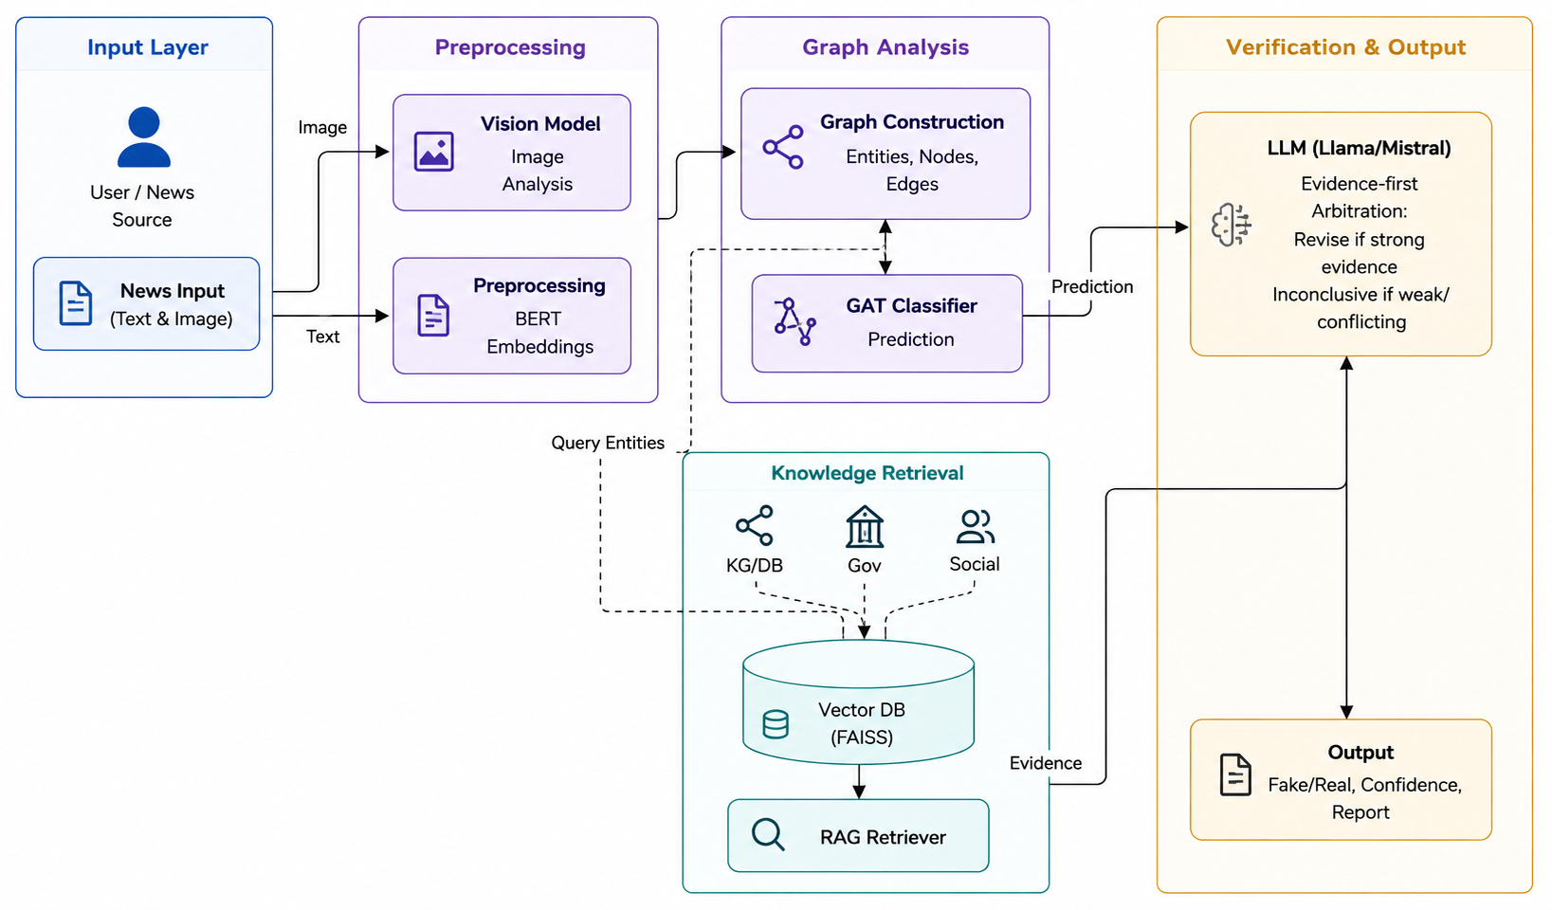
Architecture Diagram

Slide 12
Architecture Diagram Explanation
The proposed architecture combines Graph Attention Networks (GAT) with Retrieval-Augmented Generation (RAG) and a Large Language Model (LLM) to perform accurate and explainable fake news detection. The system follows a layered architecture consisting of Input, Preprocessing, Graph Analysis, Knowledge Retrieval, and Verification & Output modules.
Input layer: The user provides a news article containing text and an optional image. This multimodal input is used for both graph-based classification and evidence retrieval.
Preprocessing layer: The text is cleaned, tokenized, and converted into semantic embeddings using BERT, while the image is analyzed using a vision model. These representations capture the contextual meaning of the news content.
Graph analysis layer: Entities extracted from the article are used to construct a graph where nodes represent the news article and related entities, and edges represent their relationships. The Graph Attention Network (GAT) learns the importance of these relationships and predicts whether the news is fake or real.
Knowledge retrieval layer: The extracted entities are sent to the RAG retriever, which searches a FAISS vector database built from trusted news articles, government sources, and fact-check repositories. The retriever returns the most relevant evidence related to the claim.
Verification and output layer: The LLM (Llama/Mistral) receives both the GAT prediction and the retrieved evidence. It follows an evidence-first arbitration policy: if strong credible evidence supports the GAT prediction, it confirms the result; if strong evidence contradicts it, the LLM may revise the prediction; if the evidence is weak or conflicting, it returns an inconclusive result. Finally, the system generates the fake/real prediction, confidence score, supporting evidence, and an explainable verification report.

